Slide 1




Online Bus Ticket Booking System For Habesha Bus
Group 4
Project Proposal
2024 May GC

Slide 2


Introduction
Join us as we venture into the future of Ethiopian Habesha bus travel! Say goodbye to long lines and limited booking times. Please allow us to present our innovative solution, the Online Bus Ticket Reservation System. This platform, powered by the cutting-edge MERN stack, promises quick transactions and seamless accessibility from anywhere in Ethiopia. Accept the ease of real-time seat cheeking and be guaranteed to arrive on time every time. We cordially invite you to join us as we set out on this revolutionary adventure to completely transform Ethiopia's accessibility and efficiency in transportation. Greetings from a universe of endless possibilities!

Slide 3

Background of Habesha Bus
Habesha Bus, a stalwart of Ethiopian transportation, is renowned for its reliability and customer-centric approach. However, its traditional ticketing system faces challenges with accessibility, efficiency, and accuracy. As Ethiopia embraces digital transformation, there's a prime opportunity for Habesha Bus to modernize. By introducing online booking services, Habesha Bus can cater to evolving customer preferences, boost competitiveness, and overcome current operational hurdles.

Slide 4
Vision and Goals
Vision
1
Habesha Bus's vision is to develop a robust system that revolutionizes the bus transportation industry in Ethiopia. By providing a seamless and convenient online booking platform, the company aims to enhance customer experience and optimize operational efficiency for bus operators.
2
Goal 1
To launch the online bus ticket booking platform by 1st September 2024.
Goal 2
3
To increase customer satisfaction by 30% within the first six months of platform launch.
4
Goal 3
To on-board at least 50 bus operators onto the platform within the first year of operation.

Slide 5
Statement of Problem
Manual Ticket Booking Process
The current manual ticket booking process leads to inefficiencies and long queues at ticket counters
Limited Accessibility
Customers face challenges in accessing bus tickets conveniently due to the absence of an online booking platform
Customer Demand for Convenience
Operational Inefficiencies
Tech-savvy travellers expect seamless online booking options for bus tickets, which are currently unavailable
The lack of an online booking system impacts operational efficiency and restricts revenue growth opportunities for the business.

Slide 6
Cont…
Limited operating hours of Habesha's booking centres, which hinder the flexibility of booking, as they are only accessible during standard working hours
Restricted access to booking services, particularly for passengers residing in remote areas, due to the centralized location of Habesha's booking centres

Slide 7
Justifications
1
Addressing Inefficiencies
2
Enhancing Customer Experience
Implementing an online bus ticket booking service will streamline the ticketing process and reduce operational bottlenecks
The online platform will offer customers convenience, flexibility, and instant ticket reservations, improving overall satisfaction
3
Competitive Edge
4
Cost Savings
Embracing digital solutions aligns with industry trends and positions the business as a leader in meeting customer expectations
Transitioning to online ticketing can reduce overhead costs associated with manual ticketing processes, leading to improved financial efficiency

Slide 8

Objectives of the Project
General Objective
To develop an online bus ticket reservation system for the Habesha bus service in Ethiopia, aimed at enhancing accessibility, convenience, and efficiency in the bus transportation sector.
Specific Objectives
To develop a user-friendly online booking platform that offers seamless ticket reservations for bus services.
Enhance customer engagement and loyalty through personalized promotions and notifications
Provide multilingual support to accommodate diverse customer preferences
Implement a feedback mechanism to gather insights for continuous improvement

Slide 9
System Development Approach:
Waterfall Development Approach
Clarity of Requirements
Comprehensive Planning
Quality Assurance
The waterfall model's focus on rigorous testing and validation at each stage ensures that the system meets the required quality standards and performs as intended before deployment.
The waterfall model is ideal when project requirements are well-understood and unlikely to change significantly throughout the development process, as is the case with the online bus ticket reservation system.
The waterfall model emphasizes thorough documentation and planning at the outset of the project, enabling the creation of a detailed blueprint of the system architecture and functionality.

Slide 10
System Development Tools:
The MERN Stack Advantage
Software Tools:
Programming Languages: JavaScript for front-end and back-end development, leveraging Node.js and React.
Frameworks and Libraries: Tailwind CSS for styling and responsive design.
Database Management System: Mongo DB for flexible and scalable data storage and management.
Version Control System: Git for collaborative development and code tracking.
Integrated Development Environment (IDE): Visual Studio Code, optimized for MERN stack development.
Testing Tools: Jest and Enzyme for comprehensive testing of React components.

Slide 11
Functional Requirements
Admin Capabilities
Operator Essentials
User-Centric Design
•User and Operator Management: Manage accounts and permissions.
•Route and Price Approval: Review and approve routes and prices.
•Monitoring and Reporting: Track system performance and generate reports.
•System Maintenance: Maintain and update the system.
•Bus Management: Maintain buses, add or remove from service.
•Route Management: Create, update, and adjust bus routes.
•Price Management: Set and adjust ticket prices.
•Schedule Management: Create and modify bus schedules.
•Booking Management: Facilitate ticket bookings and inventory.
•Customer Service: Ensure passenger satisfaction and address inquiries.
•Searching: Easily search for available buses, routes, and schedules.
•Booking: Seamlessly book tickets for desired routes, with options to choose seats and view pricing.
•Payment: Securely complete transactions using various payment methods supported by the system.
•Seat Management: Select preferred seats during booking, including viewing seat availability and choosing seat preferences.
•Account Management: Create, update, and view account details, including booking history and preferences.

Slide 12
Non-Functional Requirements: Ensuring Quality and Reliability
1
Performance
2
Security
The platform should load quickly and respond to user actions promptly, with minimal latency.
It should be able to handle concurrent user requests and peak traffic loads without degradation in performance
The platform should implement robust security measures to protect user data, including encryption of sensitive information and secure authentication mechanisms.
3
Usability
4
Reliability
The platform should have an intuitive and user-friendly interface, with clear navigation and well-organized content.
It should provide helpful guidance and feedback to users throughout the booking process, minimizing the need for user assistance.
The platform should be highly available and reliable, with minimal downtime and system failures.
It should have backup and recovery mechanisms in place to ensure data integrity and continuity of service in case of unexpected events.

Slide 13
Cont…
5
Scalability
The platform should be scalable to accommodate future growth in user traffic and data volume.
It should be able to scale horizontally by adding more servers or resources to handle increased demand effectively.

Slide 14
Scope and Limitations: Balancing Ambition and Realism
Comprehensive Scope
Payment Constraints
The project's scope encompasses a wide range of features, from bus route searches and seat selection to secure online payment processing and user registration. This comprehensive approach aims to streamline the reservation process and provide a reliable and convenient experience for travellers.
While the platform strives to offer a diverse range of payment options, it may be limited in its ability to support all preferred methods, potentially excluding users with limited access to conventional banking services.
Internet Dependency
The platform's reliance on stable internet connectivity may pose challenges in regions with unreliable or limited internet infrastructure, potentially impacting user access and the overall accessibility of the service.

Slide 15

Significance: Transforming the Transportation Landscape
Enhanced Passenger Experience
The platform aims to elevate the passenger experience by providing a user-friendly and convenient booking process, real-time route information, and secure payment options, leading to increased satisfaction and loyalty among travellers.
Industry Modernization
By define digital technologies and online platforms, the project represents a significant step towards modernizing and digitizing the transportation industry, fostering innovation, efficiency, and adaptability within the sector.
1
2
3
Operational Efficiency
For bus operators, the platform streamlines ticketing operations, optimizing seat allocation, minimizing errors, and enhancing overall efficiency.

Slide 16




Significance: Empowering Stakeholders
Accessibility
Competitive Edge
Revenue Generation
Sustainability
The platform enhances accessibility to bus services by enabling passengers to search, and book tickets from the comfort of their homes or on the go, promoting greater mobility and flexibility for travellers.
By promoting the use of public transportation and reducing reliance on individual vehicles, the platform supports environmental sustainability efforts, contributing to reduced traffic congestion and lower carbon emissions.
By offering modernized and customer-centric services, the platform provides bus operators with a competitive edge, allowing them to attract and retain passengers, differentiate themselves from competitors, and capture a larger share of the market.
The platform presents revenue generation opportunities for bus operators through value-added services, such as ancillary products, as well as targeted marketing and promotional campaigns.

Slide 17
Beneficiaries of the Online Bus Ticket Booking Platform
Passengers: Elevated Travel Experience
Enhanced Convenience
Improved Accessibility
Elevated Experience
Passengers will enjoy unparalleled convenience and flexibility in booking bus tickets, with the ability to reserve seats, select preferred routes, and make secure payments online.
The platform will democratize access to bus travel, benefiting passengers from all walks of life, including those in remote areas or with limited access to traditional ticketing outlets.
By streamlining the booking process and providing real-time route information, passengers will experience heightened satisfaction and comfort, fostering greater loyalty to bus operators.

Slide 18
Bus Operators: Operational Efficiency and Revenue Growth
Operational Efficiency
Revenue Growth
Competitive Advantage
Bus operators will benefit from streamlined ticketing processes, automated seat allocations, and enhanced scheduling capabilities, leading to significant cost savings and improved operational efficiency.
The platform presents new revenue opportunities for bus operators through value-added services, targeted marketing campaigns, and ancillary product offerings, bolstering profitability and business growth.
By embracing digital transformation, bus operators can differentiate themselves in a competitive market, attracting new passengers and strengthening their market position.

Slide 19
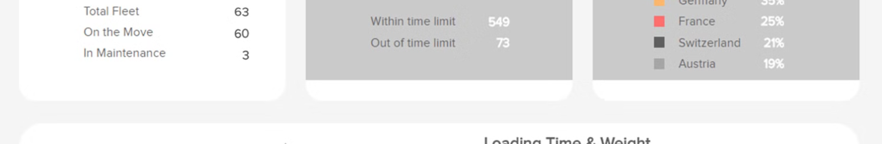
Administrators and Managers: Efficient Management and Streamlined Administration
Efficient Management
Streamlined Administration
Administrators and managers will have access to comprehensive dashboards and reporting tools, enabling them to monitor booking activities, analyse performance metrics, and make data-driven decisions to optimize operations.
The platform simplifies administrative tasks such as route management, fare adjustments, freeing up valuable time and resources for strategic initiatives.

Slide 20


Exclusive Features: Multilingual Interface and Chapa Payment Integration
Multilingual Support
Chapa Payment Integration
The project will include support for the Amharic language in addition to English, accommodating users who prefer to interact with the platform in their native language, thereby enhancing accessibility and user experience.
Real payments will be facilitated through Chapa, a widely used payment method in the region. This integration aims to provide users with a familiar and convenient payment option, ensuring seamless and secure transactions for bus ticket bookings.

Slide 21
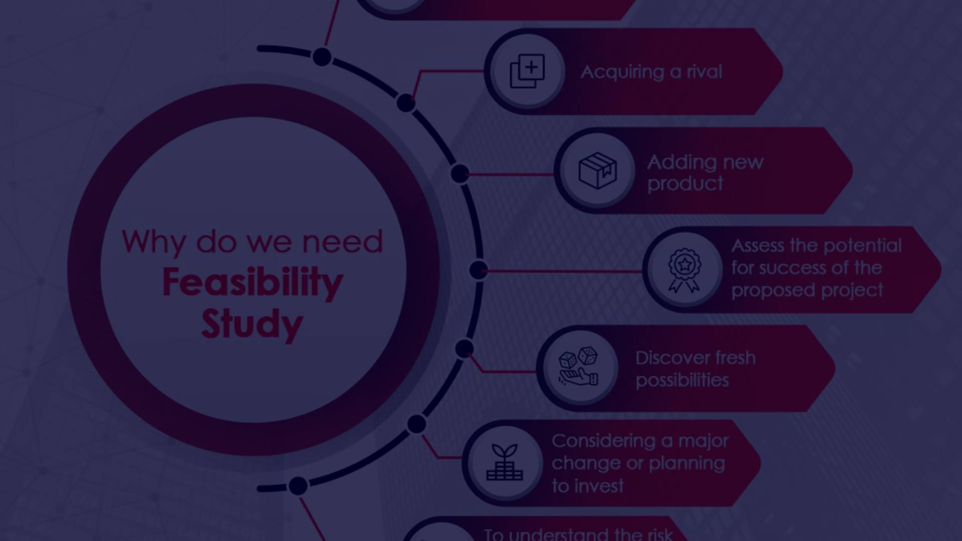
Feasibility Study: Ensuring Project Success
Economic Feasibility
The project's economic viability is assessed, considering factors such as cost of system investigation, manpower requirements, and maintenance costs to ensure the anticipated financial gains outweigh the incurred expenses.
Operational Feasibility
The operational feasibility assessment examines the alignment of the project with existing business processes, organizational capabilities, and user acceptance to ensure successful adoption and implementation.
1
2
3
Technical Feasibility
The technical feasibility analysis evaluates the compatibility, capacity, and scalability of the technology stack and equipment required to support the system development and operations effectively.

Slide 22

Risks and Mitigation Strategies
1
Cyber Security Threats
2
Technical Disruptions
Strong cyber security measures are also required since cyber security threats like data breaches put platform security and user privacy at risk.
Technical problems or system malfunctions may also cause disruptions to operations and negatively affect user experience.
3
Market Volatility
4
payment method
These could include unforeseen modifications to consumer preferences or economic downturns that affect the market.
Exclusivity of Chapa payment method may alienate users who prefer other payment options.

Slide 23
Key Features of this Online Booking Platform
Real-time Availability
Passengers can view real-time seat availability and make reservations from the comfort of their homes or on-the-go, eliminating the need to visit booking centers.
Secure Payments
The platform will offer secure and convenient payment options, allowing customers to complete their bookings with confidence.
Notifications and Updates
Operator Integration
Passengers will receive timely notifications about schedule changes, seat availability, and route modifications, keeping them informed throughout their journey.
The platform will seamlessly integrate with bus operators, enabling them to manage their schedules, inventory, and customer data efficiently.

Slide 24
Roles in the MERN Stack Development Team
1
Fikadu Getaye
2
Liben Bekele
5
Dobiey Yiel
Full Stack Developer: Fikadu oversees both the frontend and backend development, ensuring everything works together smoothly to create a seamless user experience.
Backend Developer: Liben builds the core functionality of the application and handles data processing on the server-side.
Database Developer: Dobiey sets up and manages the database where all the data for the application is stored.
3
Hirpha Jemama
4
Mikias Erkihun
Frontend Developer: Hirpha creates the visual interface that users interact with, making sure it's intuitive and easy to use.
Server-side Developer: Mikias works on the server-side code that powers the application, handling things like user authentication and data retrieval.

